Slide 1
CS4104 Applied Machine Learning
Decision Tree Classifier

Slide 2
Classification Techniques
Decision Tree based Methods
Rule-based Methods
Memory based reasoning
Neural Networks
Naïve Bayes and Bayesian Belief Networks
Support Vector Machines

Slide 3


Example of a Decision Tree
Splitting Attributes
Tid | Refund | Marital Status | Taxable Income | Cheat
1 | Yes | Single | 125K | No
2 | No | Married | 100K | No
3 | No | Single | 70K | No
4 | Yes | Married | 120K | No
5 | No | Divorced | 95K | Yes
6 | No | Married | 60K | No
7 | Yes | Divorced | 220K | No
8 | No | Single | 85K | Yes
9 | No | Married | 75K | No
10 | No | Single | 90K | Yes
Refund
Yes
No
NO
MarSt
Single, Divorced
Married
TaxInc
NO
< 80K
> 80K
NO
YES
10
Training Data
Model: Decision Tree

Slide 4


Another Example of Decision Tree
MarSt
Single, Divorced
Married
Tid | Refund | Marital Status | Taxable Income | Cheat
1 | Yes | Single | 125K | No
2 | No | Married | 100K | No
3 | No | Single | 70K | No
4 | Yes | Married | 120K | No
5 | No | Divorced | 95K | Yes
6 | No | Married | 60K | No
7 | Yes | Divorced | 220K | No
8 | No | Single | 85K | Yes
9 | No | Married | 75K | No
10 | No | Single | 90K | Yes
NO
Refund
Yes
No
NO
TaxInc
< 80K
> 80K
NO
YES
There could be more than one tree that fits the same data!
10

Slide 5

Decision Tree Classification Task
Tree Induction algorithm
Induction
Tid | Attrib1 | Attrib2 | Attrib3 | Class
1 | Yes | Large | 125K | No
2 | No | Medium | 100K | No
3 | No | Small | 70K | No
4 | Yes | Medium | 120K | No
5 | No | Large | 95K | Yes
6 | No | Medium | 60K | No
7 | Yes | Large | 220K | No
8 | No | Small | 85K | Yes
9 | No | Medium | 75K | No
10 | No | Small | 90K | Yes
Learn Model
10
Training Set
Model
Apply Model
Decision Tree
Tid | Attrib1 | Attrib2 | Attrib3 | Class
11 | No | Small | 55K | ?
12 | Yes | Medium | 80K | ?
13 | Yes | Large | 110K | ?
14 | No | Small | 95K | ?
15 | No | Large | 67K | ?
Deduction
10
Test Set

Slide 6
Apply Model to Test Data
Start from the root of tree.
Test Data
Refund | Marital Status |  |  | Taxable Income | Cheat
No | Married |  | 80K |  | ?
Refund
Yes
No
10
NO
MarSt
Single, Divorced
Married
TaxInc
NO
< 80K
> 80K
NO
YES

Slide 7
Apply Model to Test Data
Test Data
Refund | Marital Status |  |  | Taxable Income | Cheat
No | Married |  | 80K |  | ?
Refund
10
Yes
No
NO
MarSt
Single, Divorced
Married
TaxInc
NO
< 80K
> 80K
NO
YES

Slide 8
Apply Model to Test Data
Test Data
Refund | Marital Status |  |  | Taxable Income | Cheat
No | Married |  | 80K |  | ?
Refund
10
Yes
No
NO
MarSt
Single, Divorced
Married
TaxInc
NO
< 80K
> 80K
NO
YES

Slide 9
Apply Model to Test Data
Test Data
Refund | Marital Status |  |  | Taxable Income | Cheat
No | Married |  | 80K |  | ?
Refund
10
Yes
No
NO
MarSt
Single, Divorced
Married
TaxInc
NO
< 80K
> 80K
NO
YES

Slide 10
Apply Model to Test Data
Test Data
Refund | Marital Status |  |  | Taxable Income | Cheat
No | Married |  | 80K |  | ?
Refund
10
Yes
No
NO
MarSt
Single, Divorced
Married
TaxInc
NO
< 80K
> 80K
NO
YES

Slide 11
Apply Model to Test Data
Test Data
Refund | Marital Status |  |  | Taxable Income | Cheat
No | Married |  | 80K |  | ?
Refund
10
Yes
No
NO
MarSt
Married
Assign Cheat to “No”
Single, Divorced
TaxInc
NO
< 80K
> 80K
NO
YES

Slide 12
Exercise
Refund | Marital Status |  |  | Taxable Income | Cheat
No | Single |  | 80K |  | ?
Yes | Single |  | 100K |  | ?
Yes | Married |  | 1K |  | ?
Yes | Divorced |  | 50K |  | ?
10

Slide 13
Decision Tree Induction
Many Algorithms:
Hunt’s Algorithm (one of the earliest)
CART
– ID3, C4.5
SLIQ,SPRINT

Slide 14
Decision Tree Based Classification: Advantages
Inexpensive to construct
Extremely fast at classifying unknown records
Easy to interpret for small-sized trees
Accuracy is comparable to other classification
techniques for many simple data sets

Slide 15
DECISION TREE
An internal node is a test on an attribute
A branch represents an outcome of the test, e.g., Color=red
A leaf node represents a class label or class label distribution
At each node, one attribute is chosen to split training examples into distinct classes as much as possible
A new case is classified by following a matching path to a leaf node

Slide 16
Weather Data: Play or not Play?
Outlook | Temperature | Humidity | Windy | Play?
sunny | hot | high | false | No
sunny | hot | high | true | No
overcast | hot | high | false | Yes
rain | mild | high | false | Yes
rain | cool | normal | false | Yes
rain | cool | normal | true | No
overcast | cool | normal | true | Yes
sunny | mild | high | false | No
sunny | cool | normal | false | Yes
rain | mild | normal | false | Yes
sunny | mild | normal | true | Yes
overcast | mild | high | true | Yes
overcast | hot | normal | false | Yes
rain | mild | high | true | No
Note:
Outlook is the Forecast,
no relation to Microsoft email program

Slide 17
Example Tree for “Play?”
Outlook
sunny
overcast
rain
Humidity
Yes
Windy
high
normal
true
false
No
Yes
No
Yes

Slide 18
Building Decision Tree
Top-down tree construction
At start, all training examples are at the root
Partition the examples recursively by choosing one attribute each time
Bottom-up tree pruning
Remove subtrees or branches, in a bottom-up manner, to improve the estimated accuracy on new cases
19

Slide 19
Choosing the Splitting Attribute
At each node, available attributes are evaluated on the basis of separating the classes of the training examples. A Goodness function is used for this purpose
Typical goodness functions:
information gain (ID3/C4.5)
accuracy
gini index
others (information gain ratio)

Slide 20
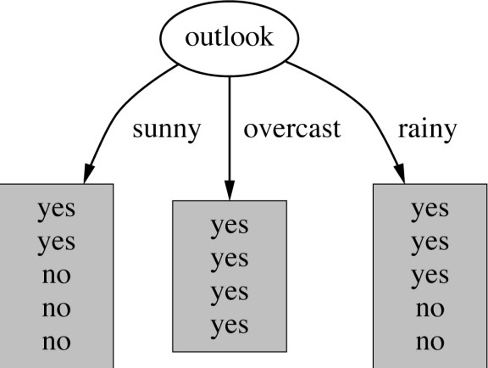
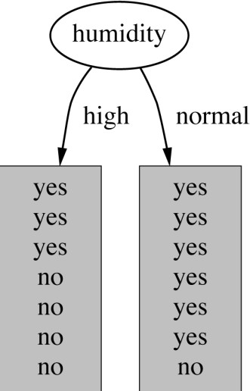
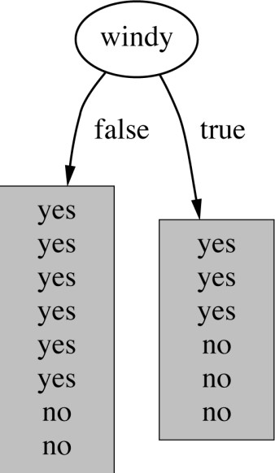
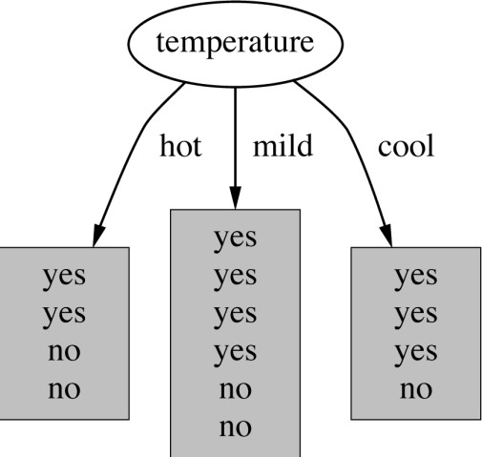
Which attribute to select?
21

Slide 21
A criterion for attribute selection
Which is the best attribute?
The one which will result in the smallest tree
Heuristic: choose the attribute that produces the
“purest” nodes
Popular impurity criterion: information gain
Information gain increases with the average purity of the subsets that an attribute produces
Strategy: choose attribute that results in greatest information gain

Slide 22
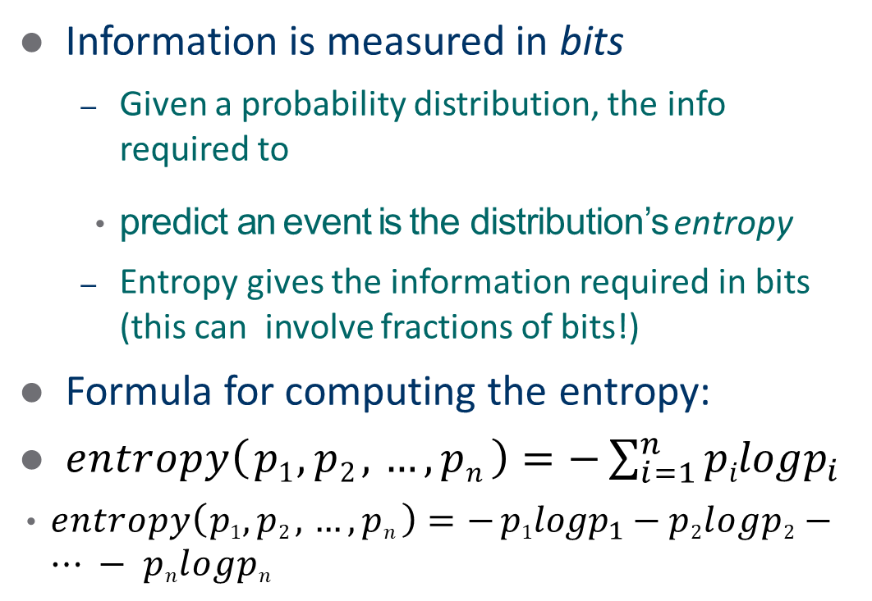
Computing information
Information is measured in bits
Given a probability distribution, the info required to
predict an event is the distribution’s entropy
Entropy gives the information required in bits (this can involve fractions of bits!)
Formula for computing the entropy:
$entropy\left( p1 , p2 , …,pn \right)=−\sum_{i=1}^{n}{pilogp_{i}}$
$entropy\left( p1 , p2 , …,pn \right)=− p1logp_{1}−p2logp2−…−pnlogpn$
23

Slide 23
Example: attribute “Outlook”
“Outlook” = “Sunny”:
info([2,3]) = entropy(2/5,3/5) = −2 / 5log(2 / 5) − 3 / 5log(3 / 5) = 0.971 bits
“Outlook” = “Overcast”:
info([4,0]) = entropy(1,0) = −1log(1) − 0 log(0) = 0 bits
“Outlook” = “Rainy”:
Note: log(0) is not defined, but we evaluate 0*log(0) as zero
info([3,2]) = entropy(3/5,2/5) = −3 / 5log(3 / 5) − 2 / 5log(2 / 5) = 0.971 bits
Expected information for attribute:
info([2,3],[4,0],[3,2]) = (5 /14) × 0.971+ (4 /14) × 0 + (5 /14) × 0.971
= 0.693 bits
witten&eibe

Slide 24
Computing the information gain
Information gain:
(information before split) – (information after split)
gain("Outlook") = info([9,5]) - info([2,3],[4,0],[3,2]) = 0.940 - 0.693
= 0.247 bits
Information gain for attributes from weather data:
gain("Outlook") = 0.247 bits gain("Temperature") = 0.029 bits gain("Humidity") = 0.152 bits gain("Windy") = 0.048 bits

Slide 25
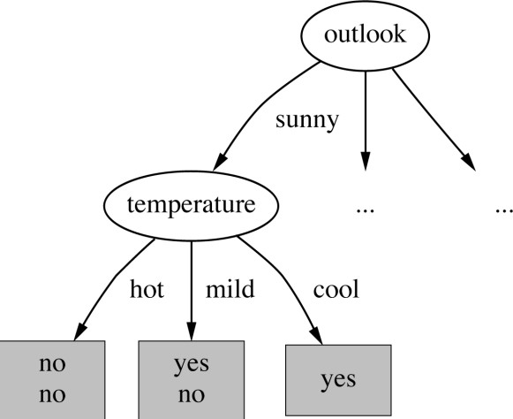
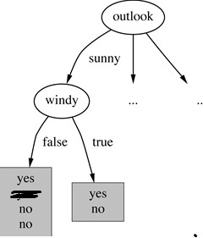
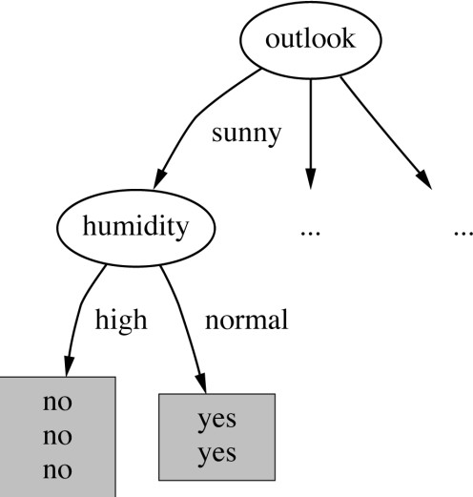
Continuing to split
gain("Humidity") = 0.971 bits
gain("Temperature") = 0.571 bits

Slide 26
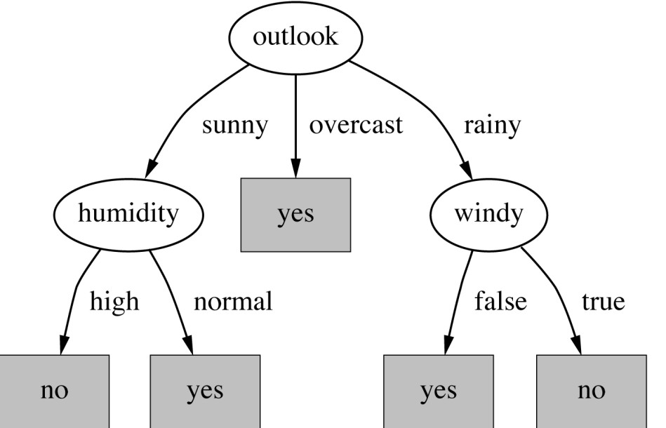
The final decision tree
Note: not all leaves need to be pure; sometimes identical instances have different classes
⇒ Splitting stops when data can’t be split any further

Slide 27

CART Splitting Criteria: Gini Index
index, gini(T) is defined as
$gini\left(T\right)=1−\sum_{j=1}^{n}{p_{j}^{2}}$
where $p_{j}$ is the relative frequency of class j in T. gini(T) is minimized if the classes in T are skewed.

Slide 28
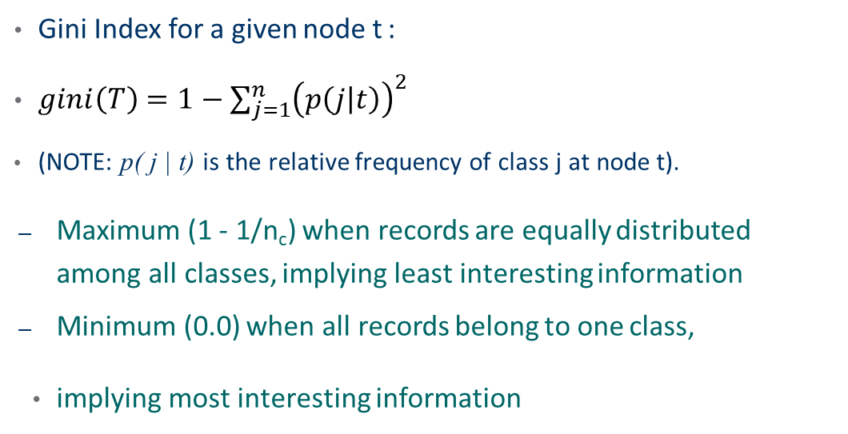
Measure of Impurity: GINI
Gini Index for a given node t :
$gini\left(T\right)=1−\sum_{j=1}^{n}{{\left(p\left(j | t\right)\right)}^{2}}$
(NOTE: p( j | t) is the relative frequency of class j at node t).
Maximum (1 - 1/n_{c}) when records are equally distributed among all classes, implying least interesting information
Minimum (0.0) when all records belong to one class,
implying most interesting information
C1 | 0
C2 | 6
Gini=0.000
C1 | 1
C2 | 5
Gini=0.278
C1 | 2
C2 | 4
Gini=0.444
C1 | 3
C2 | 3
Gini=0.500

Slide 29
Examples for computing GINI
GINI (t) = 1− ∑[ p( j | t)]²
j
P(C1) = 0/6 = 0 P(C2) = 6/6 = 1
Gini = 1 – P(C1)² – P(C2)² = 1 – 0 – 1 = 0
P(C1) = 1/6 P(C2) = 5/6
Gini = 1 – (1/6)² – (5/6)² = 0.278
P(C1) = 2/6 P(C2) = 4/6
Gini = 1 – (2/6)² – (4/6)² = 0.444
C1 | 0
C2 | 6
C1 | 1
C2 | 5
C1 | 2
C2 | 4

Slide 30
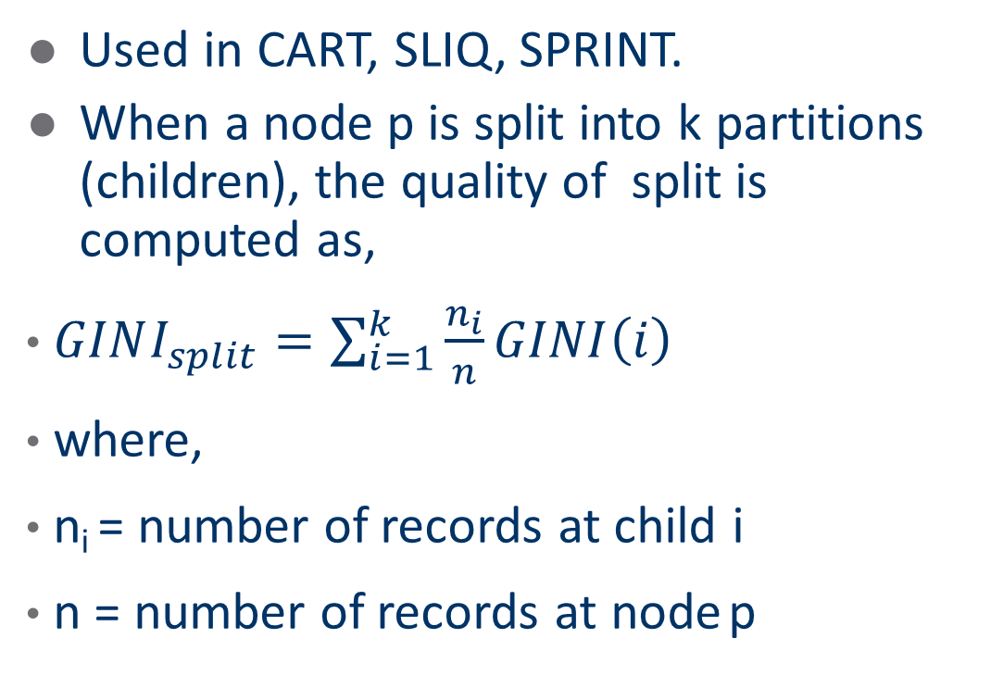
Splitting Based on GINI
Used in CART, SLIQ, SPRINT.
When a node p is split into k partitions (children), the quality of split is computed as,
$GINI_{split}=\sum_{i=1}^{k}{\frac{n_{i}}{n}GINI\left(i\right)}$
where,
n_{i} = number of records at child i
n = number of records at node p

Slide 31

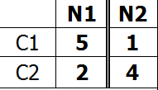
Binary Attributes: Computing GINI Index
Splits into two partitions Effect of Weighing partitions:
– Larger and Purer Partitions are sought for.
B?
 | Parent
C1 | 6
C2 | 6
Gini = 0.500
Yes
No
Node N1
Node N2
Gini(N1)
= 1 – (5/7)² – (2/7)²
= 0.408
Gini(N2)
= 1 – (1/5)² – (4/5)²
= 0.32
Gini(Children)
= 7/12 * 0.408 + 5/12 * 0.32
= 0.371

Slide 32
Categorical Attributes: Computing Gini Index
For each distinct value, gather counts for each class in the dataset
Use the count matrix to make decisions
Multi-way split
Two-way split
(find best partition of values)
 | CarType
 | Family | Sports | Luxury
C1 | 1 | 2 | 1
C2 | 4 | 1 | 1
Gini | 0.393
 | CarType
 | {Sports, Luxury} | {Family}
C1 | 3 | 1
C2 | 2 | 4
Gini | 0.400
 | CarType
 | {Sports} | {Family, Luxury}
C1 | 2 | 2
C2 | 1 | 5
Gini | 0.419

Slide 33
Continuous Attributes: Computing Gini Index
Use Binary Decisions based on one value
Several Choices for the splitting value
Number of possible splitting values
= Number of distinct values
Each splitting value has a count matrix
associated with it
Class counts in each of the partitions, A
< v and A ≥ v
Simple method to choose best v
For each v, scan the database to gather count matrix and compute its Gini index
Computationally Inefficient! Repetition
of work.
Tid | Refund | Marital Status | Taxable Income | Cheat
1 | Yes | Single | 125K | No
2 | No | Married | 100K | No
3 | No | Single | 70K | No
4 | Yes | Married | 120K | No
5 | No | Divorced | 95K | Yes
6 | No | Married | 60K | No
7 | Yes | Divorced | 220K | No
8 | No | Single | 85K | Yes
9 | No | Married | 75K | No
10 | No | Single | 90K | Yes
10
Taxable Income
> 80K?
Yes
No

Slide 34
Continuous Attributes: Computing Gini Index...
For efficient computation: for each attribute,
Sort the attribute on values
Linearly scan these values, each time updating the count matrix and computing gini index
Choose the split position that has the least gini index
Cheat | No |  |  | No |  |  | No |  | Yes |  |  | Yes |  |  | Yes |  | No |  | No |  | No |  | No
 | Taxable Income
 | 60 |  |  | 70 |  |  | 75 |  | 85 |  |  | 90 |  |  | 95 |  | 100 |  | 120 |  | 125 |  | 220
 | 55 |  | 65 |  |  | 72 |  | 80 |  |  | 87 |  |  | 92 |  | 97 |  | 110 |  | 122 |  | 172 |  | 230
 | <= | > | <= |  | > | <= | > | <= |  | > | <= |  | > | <= | > | <= | > | <= | > | <= | > | <= | > | <= | >
Yes | 0 | 3 | 0 |  | 3 | 0 | 3 | 0 |  | 3 | 1 |  | 2 | 2 | 1 | 3 | 0 | 3 | 0 | 3 | 0 | 3 | 0 | 3 | 0
No | 0 | 7 | 1 |  | 6 | 2 | 5 | 3 |  | 4 | 3 |  | 4 | 3 | 4 | 3 | 4 | 4 | 3 | 5 | 2 | 6 | 1 | 7 | 0
Gini | 0.420 |  | 0.400 |  |  | 0.375 |  | 0.343 |  |  | 0.417 |  |  | 0.400 |  | 0.300 |  | 0.343 |  | 0.375 |  | 0.400 |  | 0.420
Sorted Values Split Positions

Slide 35
Splitting Criteria based on Classification Error
Classification error at a node t :
Error(t) = 1− max P(i | t)
i
Measures misclassification error made by a node.
Maximum (1 - 1/n_{c}) when records are equally distributed among all classes, implying least interesting information
Minimum (0.0) when all records belong to one class, implying
most interesting information

Slide 36
Examples for Computing Error
Error(t) = 1− max P(i | t)
i
C1 | 0
C2 | 6
P(C1) = 0/6 = 0 P(C2) = 6/6 = 1
Error = 1 – max (0, 1) = 1 – 1 = 0
P(C1) = 1/6 P(C2) = 5/6
Error = 1 – max (1/6, 5/6) = 1 – 5/6 = 1/6
P(C1) = 2/6 P(C2) = 4/6
Error = 1 – max (2/6, 4/6) = 1 – 4/6 = 1/3
C1 | 1
C2 | 5
C1 | 2
C2 | 4

Slide 37
Misclassification Error vs Gini
A?
 | Parent
C1 | 7
C2 | 3
Gini = 0.42
Yes
No
Node N1
Node N2
Gini(N1)
= 1 – (3/3)² – (0/3)²
= 0
Gini(N2)
= 1 – (4/7)² – (3/7)²
= 0.489
 | N1 | N2
C1 | 3 | 4
C2 | 0 | 3
Gini=0.361
Gini(Children)
= 3/10 * 0
+ 7/10 * 0.489
= 0.342
Gini improves !!

Slide 38
Tree Induction
Greedy strategy.
Split the records based on an attribute test that
optimizes certain criterion.
Issues
Determine how to split the records
How to specify the attribute test condition?
How to determine the best split?
Determine when to stop splitting

Slide 39
Stopping Criteria for Tree Induction
Stop expanding a node when all the records belong to the same class
Stop expanding a node when all the records have similar attribute values
Early termination

